Slide 1



PORIFERA-SPICULES AND SIGNIFICANCE
Delivered by-
Dr. Seema Jyoti
Associate Professor, Department of Zoology
Mangaldai College (Affiliated to Gauhati University)
Darrang, Assam, India
email Id: seema.jyoti@gmail.com

Slide 2
INTRODUCTION
Spicules (or “spikes” for short) are structural elements found in most sponges.
They provide structural support and deter predators.
Large spicules that are visible to the naked eye are referred to as megascleres, while smaller, microscopic ones are termed microscleres.
The meshing of many spicules serves as the sponge’s skeleton and thus it provides structural support and defence against predators. The composition, size, and shape of spicules is one of the largest determining factors in sponge taxonomy.

Slide 3
Structure and types
Spicules are microscopic crystalline structures which gives the sponges their rigidity and form.
Spicule consists of spines or rays that radiate from a point.
These are secreted by special mesenchymal amoebocytes called scleroblast cells.

Slide 4
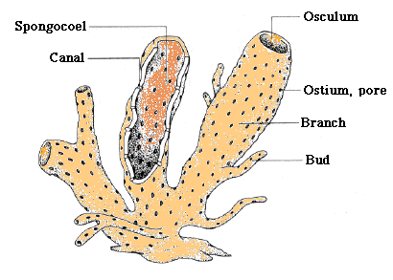
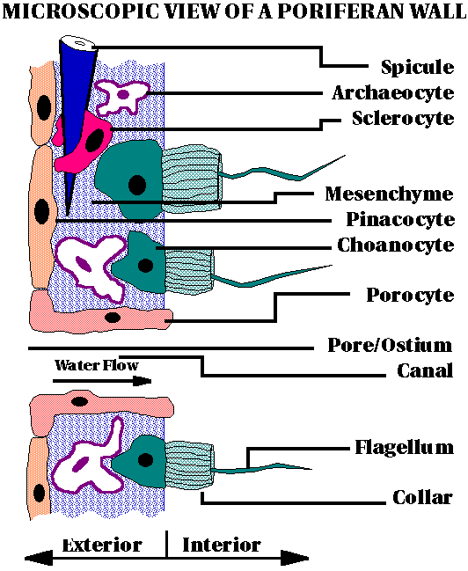

Slide 5
CLASSIFICATION OF SPICULES
The following are various types of spicules:
On basis of type of deposit on core organic matter: All kinds of spicules have a core of organic material around which either calcium carbonate or colloidal silica is deposited. Accordingly spicules are of two types:
A. Calcareous spicules: The organic material in this type of spicules is calcium carbonate or calcite. This is the characteristic of the sponges of class Calcarea.
B. Siliceous spicules: The organics material in this type of spicules is Colloidal silica or Silicon. These types of spicules are the characteristic of the sponges of class Hexactanellida.

Slide 6
On the basis of size and function: Spicules can be of large size or small size. Accordingly spicules can be of two types:
A. Megascleres: These are larger spicules constituting main skeleton of sponge body.
B. Microscleres: These are the small spicules occurring interstitially.
On the basis of number of axes and rays: Spicules may occur in several forms like the simple rod form or in the form of forks, anchors, shovels, stars, plumes etc. The spicule forms depend on the presence of number of axes and rays. Accordingly, they can be divided into the following forms:

Slide 7
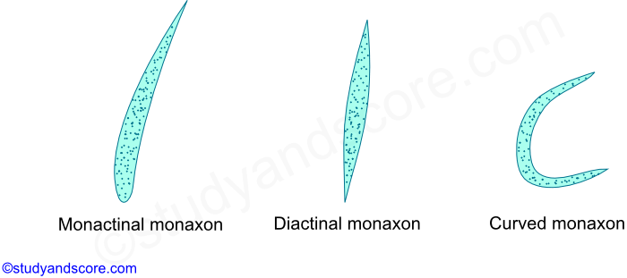
A.Monaxon: These kinds of spicules are formed by the growth along one axis. They may be straight needle-like or rod like or may be curved. Their ends may be pointed or hooked or knobbed. Monaxons can be both calcareous and siliceous types.
These monaxon spicules are further divided into two kinds,
Monactinal- the growth of the spicule takes place only in one direction
Diactinal- The growth of the spicule takes place in both the directions.

Slide 8
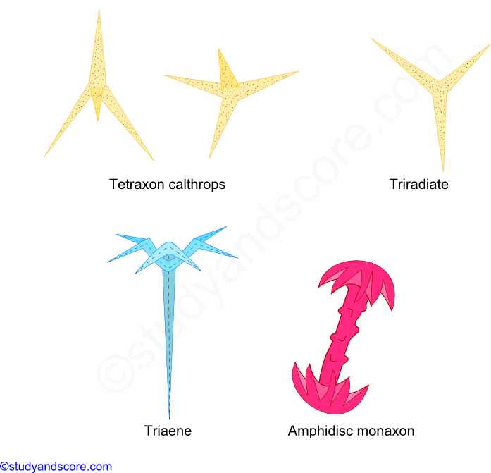
B. Tetraxon: These spicules have four rays each pointing in different direction. Usually one of the four rays is elongated giving the appearance of a crown of 3 rays. Such spicules are called as triaenes.

Slide 9
Sometimes all the rays are equal, when all the rays are equal it is termed as calthrops.
When all the four rays persist it is called as tetraradiate or quadriradiate.
Sometimes one of the rays is lost and then it is known as triradiate. These triradiate rays are characteristic of calcareous sponges.
If the elongated ray bears a disc at both ends, it is called as amphidisc.

Slide 10
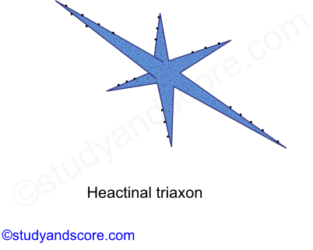
C. Triaxon:
These spicules have three axes that cross one another at right angles to produce six rays. Thus it is also called hexactinal spicule. These triaxon spicules are characteristic of glass sponges of the class Hexactanellida.

Slide 11
Polyaxon: These are the spicules with several equal rays radiating from a central point. They may be grouped to give star-like appearance. Polyaxon spicules are found along with microscleres.

Slide 12
Development of spicules
The calcareous spicules are secreted by special type of cells called as sclerocytes.
These sclerocytes are derived from binucleated mesenchymal scleroblasts.
A monaxon spicule or each ray of the triradiate spicule is secreted by a group of two sclerocytes.
Among these two sclerocytes one acts as thickener cell and the other acts as the founder cell.

Slide 13
FORMATION OF SPICULES
The spicules are secreted by specialized mesenchyme cells known as scleroblasts. Scleroblast secreting a calcareous spicule is called calcoblast while that producing a siliceous spicule is called silicoblast.
Monaxon spicules are formed because of the incomplete division of scleroblast cell giving rise to binucleate scleroblast. The two nuclei begin to move away from each other and calcium carbonate from sea water begins deposit in between the space of two nuclei in the form of an axis. As the calcium carbonate needle between the two nuclei begins to lengthen, the cell divides into two, the founder cell and the thickener cell. When the spicule is fully formed both the cells detach and wander off into mesenchyme. Triradiate spicules are secreted by three scleroblast cell which come to lie in a triangular manner.

Slide 14
SPONGIN FIBRES
Spongin is an organic horny, elastic substance consisting of scleroprotein that is rich in sulphur and is chemically similar to collagen and sericin. It contains hydroxyproline and glycine in large proportions and also contains glucosamine, glucose, galactosamine and galactose mannose, fucose, arabinose and uronic acid. Spongin is insoluble in water and acids but soluble in KOH. It is chemically inert and cannot be digested by the digestive enzymes. Spongin contains a large amount of iodine, up to 14% in certain tropical species.

Slide 15
STRUCTURE AND GROWTH OF SPONGIN
Spongin fibres are made of an axial core or medulla that is 10-50 micron wide, surrounded by helically coiled elementary fibrils which are secreted by the spongioblast cells derived from the mesenchyme. The spongioblast cells arrange themselves in rows and develop a vacuole within which spongin material is collected. Later, spongin secreted by each spongioblast cell fuses with the neighbouring cells to form long fibres. Spongin fibres form a mesh work to provide firmness to the sponge body.

Slide 16
Development of Triradiate spicule:
Rarely 3 caicoblast cells wiil come together and each one which produce a 'Monaxon' spicule. The 3 spicules are united together and a triradiate' spicule is formed. The tetraradiate spicule develops like the triradiate spicule and the fourth ray is developed from the junction of the three.

Slide 17
FUNCTIONS OF SPICULES
1) They will form a firm frame work of the body and give support to the soft body of the sycon.
2) Spicules give definite shape to the body.
3) They protect the body from disintegration by the wave action of the water.
4) They will keep open the dermal Ostia and canals throughout the life.

Slide 18
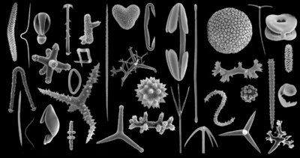
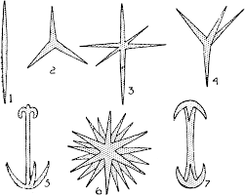
DIFFERENT SPONGE SPICULES

Slide 19
Thank you

